Slide 1

Classifying Aggressiveness of Colorectal Cancer
MIS 536 - Business Analytics
Professor : Dr. Moqri
Presented by:
Team 1 - Ajinkya Koshti, Kavita Jain, Ludmila Scott, Pallabi Chatterjee, Tyler Kutz

Slide 2
RECAP
Colorectal cancer is the second leading cause of cancer death in USA
Correctly classifying how severe someone’s cancer is important because:
Determines treatment plan
Predicts chance of recovery
Help identify clinical trials
Sets expectations

Slide 3
Agenda
Data Overview
Data Prep
Challenges
Model Selection
Prediction
Accuracy
Insights

Slide 4
About Data
939119 observations
33 categorical variables
35 variables
2 numerical variables
Link to the data : https://seer.cancer.gov/data/access.html

Slide 5
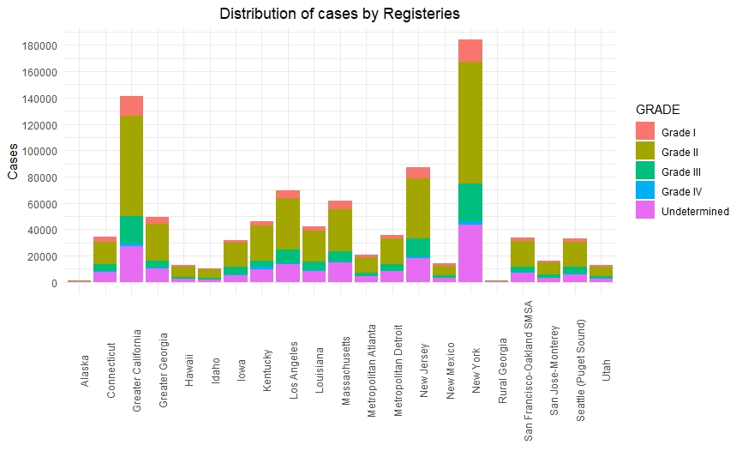
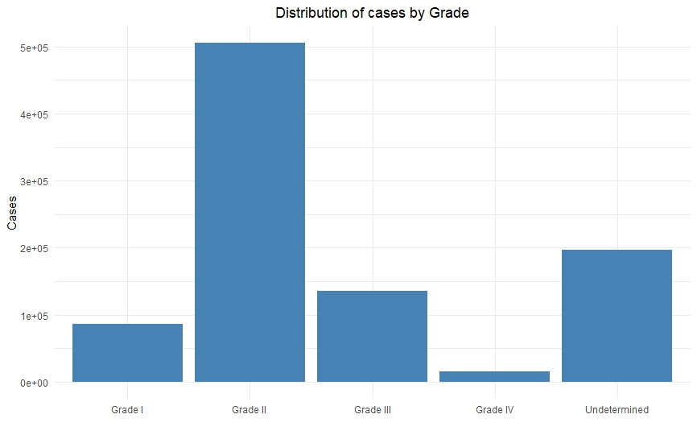
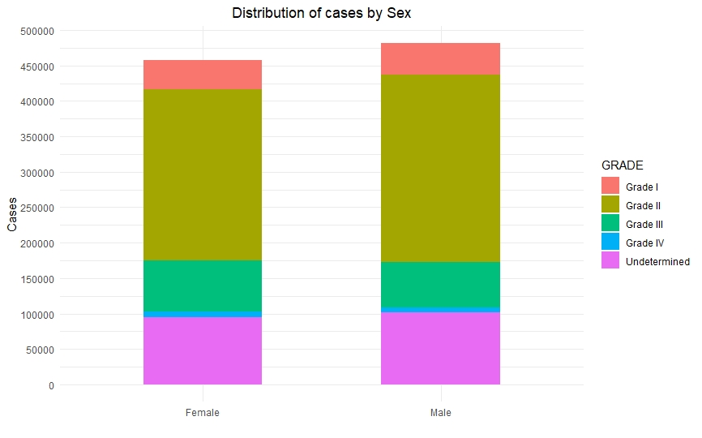
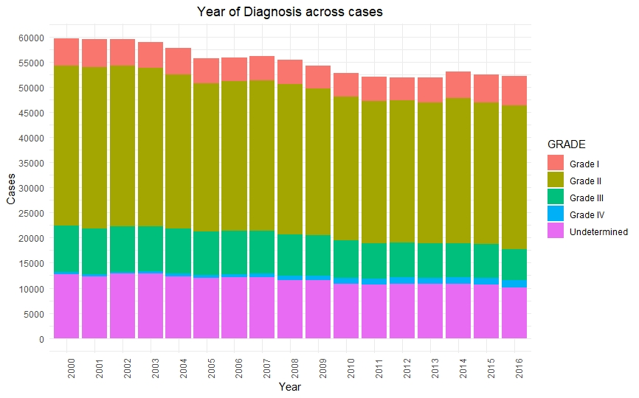
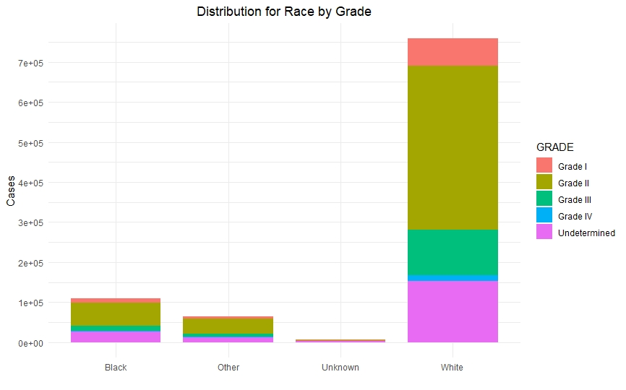
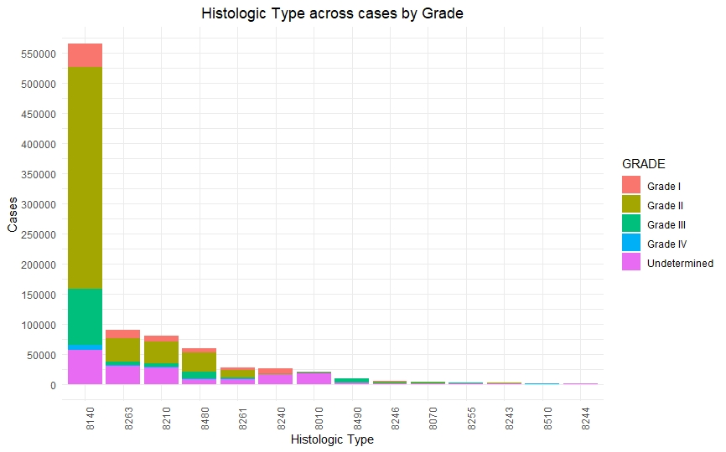
Data Exploration

Slide 6
Steps to Preprocess Data
Data Formatting - Converting encoding ASCII files into CSV files, decoding them to explore the data.
Transforming the data - we transformed our data, created dummy variables also binning our response variable i.e., Grade I, Grade II, Grade III, Grade IV into two categories 0 (combining Grade I & Grade II) and 1 (combining Grade III & Grade IV).

Slide 7
Regression Challenges
1st Attempt 2nd attempt Final Model
As.Factor
Stepwise Regression
Did not converge
Random Sampling
Manually created N-1 dummies
Biased towards Class ‘0’
79% was class 0, Accuracy was 81%
Weighted Sampling
N-1 dummies
50/50% each class
Accuracy 65%

Slide 8
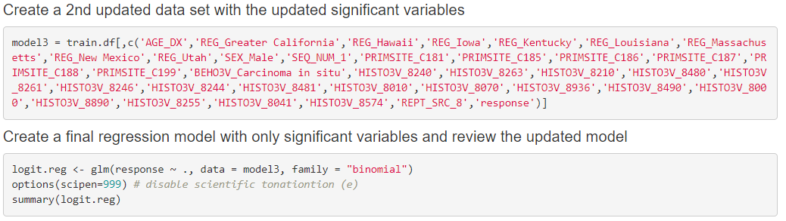
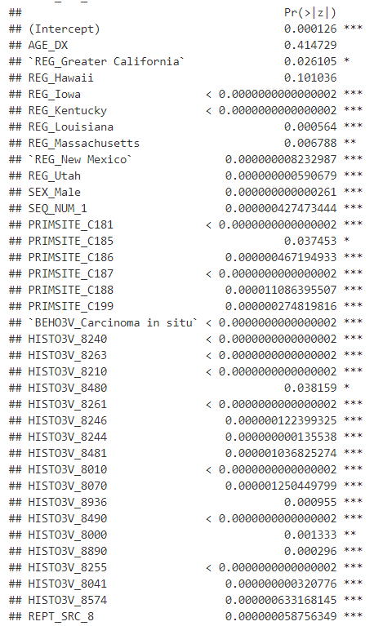
Logistic Regression
Final Model
Final Output
Initial: 255 variables
Final: Total 36 variables
(35 binary)

Slide 9
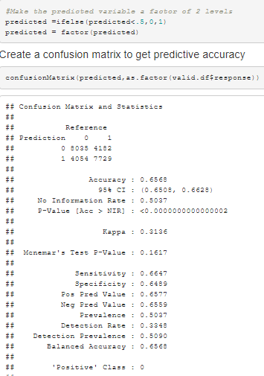
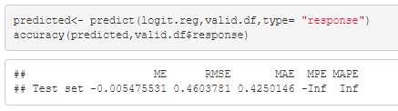
Evaluating Classification Performance
Final model can predict 65% of the validation data correctly
Before weighted sampling had 81%, but was classifying nearly all as class 0

Slide 10
Bias-variance tradeoff
Overall accuracy can be misleading
e.g. we can get 81% accuracy, but it ignores a class value that is represented by 20% of the data.
Tree-based ensemble models tend to reduce the variance
Overfitting issues
The cross-validation estimator is nearly unbiased
The bias will tend to be pessimistic (that is, overestimate the error), which is good

Slide 11
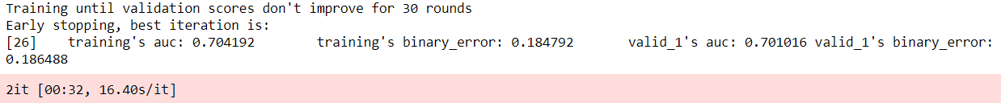
Light Gradient Boosting Machine
Light GBM is a gradient boosting framework that uses tree-based learning algorithm
Light GBM grows tree vertically while other algorithms grow trees horizontally
With 5 folds, we get an unbiased AUC (0.702) and accuracy (81.5%)
Decently close to the state-of-the-art AUC (0.79) of average survivability prediction (source: https://www.researchgate.net/publication/318661649)

Slide 12
Interesting Insights
Females are slightly more likely to have aggressive cancer (β_males = -.17)
Iowa, Kentucky, Utah higher odds of aggressive cancer
New Mexico, Hawaii, Massachusetts lower odds
Originating sites of primary tumor were significant and contributed heavily to odds
Age has little effect at β=.0007, and is considered insignificant by the model
Notes:
Less progressive states had slightly higher odds. Perhaps, lifestyles contribute?

Slide 13
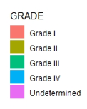
Insights: Histological Type
As suspected, histological type 8480 more likely to be grade 3 or 4 (β = .094)
8480 grouped in mucoepidermoid and neoplasms vs. adenomas and adenocarcinomas
Problems in this tissue have higher odds of being aggressive
β = Base | -1 | -.8 | .094

Slide 14
Reference
Stat software citation: Surveillance Research Program, National Cancer Institute SEER*Stat software (seer.cancer.gov/seerstat) version 8.3.4.
SEER data citation: Database name=Incidence - SEER 18 Regs Research Data + Hurricane Katrina Impacted Louisiana Cases, Nov 2016 Sub (1973-2016 varying) - Linked To County Attributes - Total U.S., 1969-2015 Counties.

Slide 15
Questions?

